Slide 1
Ch02 Python Language Fundamentals
Highlights of the chapter:
2.1 Python Program Overview
2.2 Python objects and references
2.3 Identifiers and their naming rules
2.4 Variables and Assignment Statements
2.5 Expressions and Operators
2.6 Statements
2.7 Functions
2.8 Classes and Objects
2.9 Modules and Packages
2.10 Integrated applications: turtle module and turtle mapping

Slide 2
2.1 Python Program Overview
[Example 2.1] Knowing the three sides of a triangle, find the area of the triangle (area.py). Hint: Assuming that the lengths of the three sides are a, b, and c, the area of the triangle s = .Where h is half the perimeter of the triangle
import math
a = 3.0
b = 4.0
c = 5.0
h = (a + b + c) / 2 # half the perimeter of the triangle
s = math.sqrt(h*(h-a)*(h-b)*(h-c)) #Triangle area
print(s)

Slide 3
Python program composition
Python programs can be decomposed into modules, statements, expressions, and objects. Conceptually, the correspondence is as follows:
(1) A Python program consists of modules, which correspond to source files with the extension .py. A Python program consists of one or more modules. Example 2.1 A program consists of the module area.py and the built-in module math
(2) Modules consist of statements. A module is a Python source file. When running a Python program, the statements are executed sequentially according to the order of statements in the module. In Example 2.1, import math is the import module statement; print(s) is the call function expression statement; and the rest are assignment statements.

Slide 4
Python program composition
(3) Statements are the procedural building blocks of a Python program and are used to create objects, assign values to variables, call functions, control branching, create loops, add comments, and so on. Statements contain expressions. In Example 2.1, the statement import math imports the math module and executes the statements in turn; in the statement "a = 3.0", the literal expression 3.0 creates a float object with a value of 3.0 and binds it to the variable a; in the statement "h = (a + b + c)/2", the result of the arithmetic expression (a + b + c)/2 is a new float object bound to the variable h; "#" leads to a comment statement; in the statement print(s), the built-in function print() is called, which outputs the value of object The value of s
(4) Expressions are used to create and manipulate objects. In the statement "s = math.sqrt(h*(h-a)*(h-b)*(h-c))" of the program in Example 2.1, the result of the operation of the expression h*(h-a)*(h-b)*(h-c) is a new float object, and math.sqrt calls the module math in the sqrt() function to compute the square root of the argument object

Slide 5
2.2 Python objects and references
Data Representation as Objects
An object is essentially a block of memory with a specific value that supports a specific type of arithmetic operation
Everything is an Object in Python 3
Each object is identified by identity, type and value.

Slide 6
Objects in Python (1)
An identity is used to uniquely identify an object, usually corresponding to its location in computer memory. Use the built-in function id(obj1) to return the identity of the object obj1
With the built-in id() function, you can get a unique id identifier for an object (CPython's implementation is a memory storage location)
Type (type) is used to represent the data type (class) to which the object belongs, the data type (class) is used to limit the range of values of the object, as well as the processing operations that are allowed to be performed. Use the built-in function type (obj1) can return the object obj1 belongs to the data type
With the built-in type() function, you can determine the type of an object
Value (value) is used to represent the value of the object's data type. The built-in function print(obj1) returns the value of the object obj1.

Slide 7
Objects in Python (2)
[Example 2.2] Viewing Objects Using Built-in Functions type(), id(), and print()
[Example 2.3] Viewing Python Built-in Function Objects
>>> 123 # Output: 123
>>> id(123) # Output: 140706558370656
>>> type(123) #Output: <class 'int'>
>>> print(123) #Output: 123
>>> type(abs) #output: <class 'builtin_function_or_method'>
>>> id(abs) # Output: 2529313427104
>>> type(range) #Output: <class 'type'>
>>> id(range) # Output: 140706557885440

Slide 8
Python Objects and References
When a Python program is run, various objects are created in memory (located in heap memory), objects are bound to variables (located in stack memory) through assignment statements, and objects are referenced through variables to perform various operations
Multiple variables can refer to the same object
If an object is no longer referenced by a variable in any valid scope, the memory occupied by the object is reclaimed through the automatic garbage collection mechanism

Slide 9
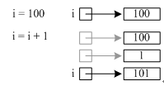
Object memory schematic (1)
Example 2.9: Example of variable incremental operation and the corresponding object memory schema
The first statement, creates an int object with the value 100 and binds it to the variable i;
In the second statement, the value of expression i+1 is computed, then an int object with value 101 is created and bound to variable i
>>> i=100
>>> i=i+1

Slide 10
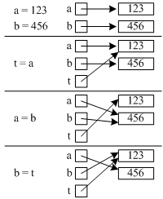
Object memory schematic (2)
[Example 2.10] Example of exchanging two variables and the corresponding object memory schematic
>>> a=123 #a points to an instance object of type int with value 123
>>> b=456 #b points to an instance object of type int with value 456
>>> t=a # The variable t, like a, points (references) to the object instance 123
>>> a=b #Variables a and b are the same, pointing to (referencing) object instances 456
>>> b=t # The variable b, like t, points (references) to the object instance 123
a,b=b,a

Slide 11
Immutable objects (immutable)
Once an immutable object is created, its value cannot be modified, e.g. int, str, complex, etc.
Example 2.12] Immutable Object Example
>>> a = 18 # variable a points to int object 18
>>> id(a) # Output: 140706365363776. indicates the id of the int object 18 pointed to by a
>>> a = 25 # variable a points to int object 25
>>> id(a) # Output: 140706365364000. indicates the id of the int object 25 pointed to by a
>>> b = 25 # variable b points to int object 25
>>> id(b) # Output: 140706365364000. indicates the id of the int object 25 pointed to by b
>>> id(25) # Output: 140706365364000. represents the id of int object 25.

Slide 12
Mutable objects (mutable)
The value of a mutable object can be modified
The mutability of a Python object depends on the design of its data type, i.e. whether it is allowed to change its value or not
Example 2.13] Variable Object Example
>>> x = y = [1, 2, 3] # Variables x and y point to list objects [1, 2, 3]
>>> id(x) # Output: 1656936944328. represents the id of the list object [1, 2, 3] pointed to by variable x
>>> id(y) # Output: 1656936944328. represents the id of the list object [1, 2, 3] pointed to by variable y
>>> x.append(4) # the list object [1, 2, 3] pointed to by variable x appends an element 4
>>> x # Output: [1, 2, 3, 4]. Represents the list object [1, 2, 3, 4] pointed to by the variable x
>>> id(x) #Output: 1656936944328. id of list object [1, 2, 3, 4] pointed to by variable x is unchanged

Slide 13
Mutable objects (mutable)
>>> x is y # Output: True. means variables x and y point to the same list object [1, 2, 3, 4].
>>> x == y # Output: True. indicates that the values of the list objects pointed to by variables x and y are equal.
>>> z = [1, 2, 3, 4] # list object [1, 2, 3, 4] pointed to by variable z
>>> id(z) # Output: 1656965757064. represents the id of the list object [1, 2, 3, 4] pointed to by variable z.
>>> x is z # Output: False. means variables x and z point to different list objects [1, 2, 3, 4].
>>> x == z # Output: True. indicates that the list objects pointed to by variables x and z are equal in value.

Slide 14
2.3 Identifiers and their naming rules
Identifiers are names of variables, functions, classes, modules and other objects
The first character of the identifier must be a letter, an underscore ("_"), and subsequent characters can be letters, underscores, or numbers
Some special names, such as if, for, and other reserved keywords, cannot be used as identifiers
For example, a_int, a_float, str1, _strname, func1 are correct variable names; while 99var, It'sOK, and for (keyword) are incorrect variable names

Slide 15
Notes on identifiers
(1) Python identifiers are case-sensitive. For example, ABC and abc are considered different names
(2) Names that begin and end with a double underscore usually have a special meaning. For example, __init__ is the constructor of a class and should generally be avoided
(3) Avoid using Python predefined identifier names as custom identifier names. For example: NotImplemented, Ellipsis, int, float, list, str, tuple, etc.

Slide 16
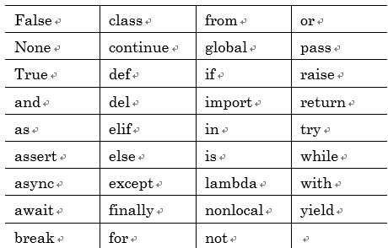
Retain keywords
Keywords are predefined reserved identifiers
Keywords cannot be used as identifiers in a program, or a compilation error will be generated
[Example 2.14] Using the Python Help System to View Keywords
>>> help()
help> keywords
help> if
help> quit

Slide 17
Python Predefined Identifiers
The Python language contains many predefined built-in classes, exceptions, functions, etc., e.g. float, ArithmeticError, print, etc.
Users should avoid using Python predefined identifier names as custom identifier names
Use Python's built-in function dir(__builtins__) to see all built-in exception names, function names, etc.

Slide 18
Naming rules followed by the Python language
typology | naming convention | give an example
Module/Package Name | All lowercase letters, simple and meaningful, with underlining if desired | math, sys
function name | All lowercase letters, which can be underlined to increase readability | foo(), my_func()
variable name | All lowercase letters, which can be underlined to increase readability | age, my_var
class name | PascalCase naming rules are used, i.e., multiple words make up the name, and each word is lowercase except for the first letter. | MyClass
constant name | All capital letters, which can be underlined to increase readability | LEFT, TAX_RATE

Slide 19
2.4 Variables and Assignment Statements
A Python object is a block of memory data located in the computer's memory.
In order to reference an object, the object must be assigned to a variable (also called binding the object to a variable) through an assignment statement
References to objects, i.e. variables
Example 2.6] Binding Objects to Variables Using Assignment Statements
>>> a=1 # Literal expression 1 creates an instance object of type int with value 1 and binds to variable a
>>> b=2 # Literal expression 2 creates an instance object of type int with value 2 and binds to variable b
>>> c=a+b #Expression a+b creates an instance object of type int with value 3 and binds to variable c

Slide 20


Variables, Assignment Statements and Object References (2)
Python also supports the following assignment statements
(1) Chained assignment
(2) Compound Assignment Statements
(3) Series unpacking assignment
Example 2.15: Example of declaration and assignment of variables
>>> x=0; y=0; z=0 # Variables x, y and z all point to int object 0. x=y=z=0
>>> str1 = "everyday" # The variable str1 points to an instance of str with the value "everyday".
>>> aFloat #Variable aFloat is not declared and defined (NameError: name 'aFloat' is not defined)

Slide 21
constant
The Python language does not support constants, i.e. there are no syntax rules restricting changing the value of a constant
The Python language uses the convention of declaring variables that do not change during program execution to be constants, usually using all capital letters (which can be underlined to increase readability) to denote the name of the constant
Example 2.6] Constant Example
>>> TAX_RATE = 0.17 # Floating point type constant TAX_RATE
>>> PI = 3.14 # Floating point type constant PI
>>> ECNU = 'East China Normal University' # string constant ECNU

Slide 22
2.5 Expressions and Operators
Composition of expressions
Operators, operators and parentheses form expressions according to certain rules
Operator priority controls the order in which each operator is calculated
[Example 2.22] Example of an expression
>>> import math #Import math module
>>> a=2;b=10 # variable a points to int object 2, variable b points to int object 10
>>> a+b #Output: 12
12
>>> math.pi # Output: 3.141592653589793
3.141592653589793
>>> math.sin(math.pi/2) #Output: 1.0
1.0

Slide 23
Rules for writing expressions
Expressions are written on the same datum from left to right. e.g. a2+b2 should be coded as a**2+b**2 (a*a+b*b)
②The multiplication sign should not be omitted; for example, the mathematical formula ab (which represents a multiplied by b) should be written as: a*b
③Parentheses must appear in pairs and only parentheses may be used; parentheses may be nested

Slide 24
operator (computing)
Operators are used to perform calculations on one or more operands in an expression and return the resultant value(s).
The order in which expressions are computed depends on the order and priority of operator combinations
You can use parentheses "()" to force a change in the order of operations.
[Example 2.24] Example of Priority of Operators in Expressions
>>> 11 + 22 * 3 # Output: 77
77
>>> (11 + 22) *3 # Output: 99
99

Slide 25
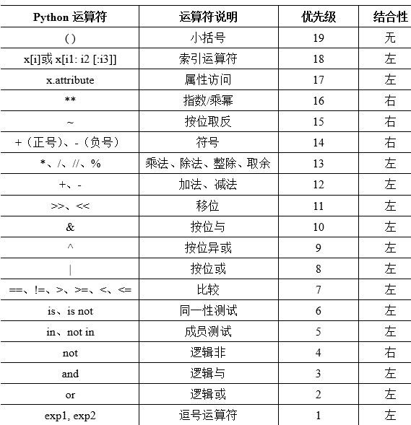
Python operators and their precedence

Slide 26
2.6 Python Statements
Statements are the procedural building blocks of a Python program, used to define functions, define classes, create objects, assign values to variables, call functions, control branches, create loops, etc.
Python statements are categorized into simple and compound statements
Simple statements include: expression statements, assignment statements, assert statements, pass null statements, del statements, return statements, yield statements, raise statements, break statements, continue statements, import statements, global statements, nonlocal statements, and so on.
Compound statements include: if statements, while statements, for statements, try statements, with statements, function definitions, class definitions, and so on.

Slide 27
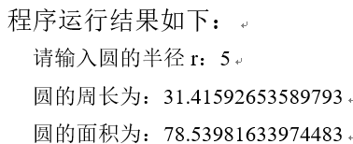
Example Python Statements
[Example 2.25] Example Python statement (statement.py): Input the radius r of a circle, calculate and output the circumference and area of the circle
import math #import statement for importing the math module
r = float(input("Please enter the radius r of the circle:")) # Assignment statement. Enter the radius r of the circle and convert to float data type
p = 2* math.pi*r # Assignment statement. Calculate the circumference of a circle
s = math.pi* r**2 # Assignment statement. Calculate the area of a circle
print("The circumference of the circle is:", p) # Output the circumference of the circle
print("The area of the circle is:", s) # Outputs the area of the circle

Slide 28
Rules for writing Python statements
(1) Use line breaks to separate statements, generally one line at a time.
(2) Beginning with the first column, there must not be any spaces before it, or a syntax error will result. Note that comment statements can start anywhere; compound statement constructors must be indented
>>> #correct
>>> print("abc") #Error. indicationError: unexpected indent

Slide 29
Rules for writing Python statements
(3) The backslash (\) is used when a code spans multiple lines. The line continuation character (\) can be used if the statement is too long
Strings defined in triple quotes (""""...""" or ''''...'''), parentheses (expressions in parentheses, arguments to function calls (in parentheses), tuples ((...)), lists ([...]), dictionaries ({ ...})), can be placed on multiple lines without having to use the line continuation character
(4) The semicolon (;) is used to write multiple statements on a single line.
>>> print("If the statement is too long, you can use the line continuation character (\), \
Continued content.")
>>> a=0; b=0; c=0 # Variables a, b, and c all point to int object 0. a=b=c=0
>>> s="abc";print(s) # Variable s points to an instance object of type str with value "abc" and outputs abc.

Slide 30
Rules for writing compound statements and their indentation
Compound statements (conditional statements, loops, function definitions, and class definitions such as if, for, while, def, class, etc.) consist of a header line and constructor blocks (suites).
A constructor statement block consists of one or more statements
(1) The header statement begins with the appropriate keyword (e.g., if), and the constructor statement block is one or more lines of indented code beginning on the next line
(2) The usual indentation is four spaces relative to the head statement, or any space, but the number of spaces indented for multiple statements in the same constructor code block must be consistently aligned. If the statement is not indented, or indented inconsistently, will result in a compilation error
(3) If conditional statements, loops, function definitions and class definitions are short, they can be placed on the same line.
>>> for i in range(1,11): print(i, end=' ')
...
1 2 3 4 5 6 7 8 9 10

Slide 31
comment statement
Starts with the symbol "#" and ends at the end of the line.Python comment statements can appear anywhere!
The Python interpreter ignores all comment statements, which do not affect the execution of the program.
[Example 2.26] Comment Statement Example
>>> #A "hello world!" program
>>> #Comments can be anywhere, starting with # and ending at the end of the line
>>> print("hello world") # Output: hello world
hello world

Slide 32
Empty statement pass
Indicates an empty code block
[Example 2.27] Example of an empty statement
>>> def do_nothing():
pass

Slide 33


2.7 Functions
Functions are blocks of code that can be called repeatedly
Creation and Calling of Functions
When creating a function, you can declare the parameters of the function, i.e., formal parameters, or formal references for short; when calling a function, you must provide the values of the parameters needed by the function, i.e., actual parameters, or real references for short.
Functions can return values using return
[Example 2.28] Example of declaring and calling a function (sayHello.py)
def sayHello(): #Create the function object sayHello
print('Hello World!') # function body
print('To get to the next level!') # Function body
sayHello()

Slide 34
2.7 Functions (2)
[Example 2.29] Declare and call the function getValue(b, r, n) to compute the final return v based on the principal amount b, the annual interest rate r, and the number of years n
def getValue(b,r,n): #Create function object getValue
v = b*((1+r)**n) #Calculate the final return v
return v # Use return to return values
total = getValue(1000,0.05,5) #call function getValue
print(f "Principal: {b}, Annual interest rate: {r:0.2%}, Duration: {n} years, Principal compounded by interest: {total:8.2f}")

Slide 35
Built-in functions (1)
dir(), type(), id(), help(), len(), sum(), max(), min(), and so on.
The input function input() and the output function print() realize user interaction.
Example 2.30] Built-in Function Usage Example 1
>>> s="The mountain of books is a path of diligence, and the sea of learning is a boat of pain."
>>> type(s) # Return the data type to which object s belongs. Output: <class 'str'>
>>> len(s) # Return the length of the string s. Output: 15
>>> s1 = [1,2,3,4,5]
>>> max(s1) # Return the maximum value of list s1. Output: 5
>>> min(s1) # Return the minimum value of list s1. Output: 1
>>> sum(s1)/len(s1) # Return the average of list s1. Output: 3.0

Slide 36

Built-in functions (2)
[Example 2.31] Built-in Function Usage Example 2 (hello2.py)
The program runs with the following results.
name = input("what's your name:")
print("Hello,",name)

Slide 37
modular function
With the import statement, you can import the module module, and then use the module.function(arguments) form to call the functions in the module.
[Example 2.32] Module Import Example 1
[Example 2.33] Module Import Example 2
>>> import math
>>> math.sin(2) #output: 0.9092974268256817
0.9092974268256817
>>> from math import sin
>>> sin(2) #Output: 0.9092974268256817
0.9092974268256817

Slide 38
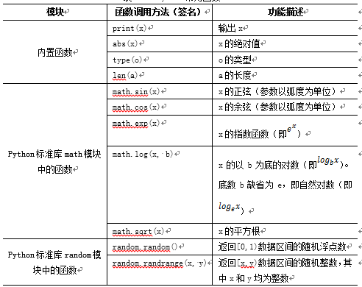
function API
The Python language provides a large number of built-in functions, standard library functions, and third-party module functions.
The method of calling the function is determined by the application programming interface (API)

Slide 39
Typical function calls in Python
function call | return value | clarification
print('Hello') | Output the string Hello on the console | built-in function
len('Hello') | 5 | built-in function
math.sin(1) | 0.8414709848078965 | Functions in the math module
math.sqrt(-1.0) | run-time error (in computing) | Square root of a negative number
random.random() | 0.3151503393010261 | Functions in the random module. Note that a different random number is generated each time

Slide 40
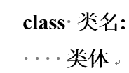
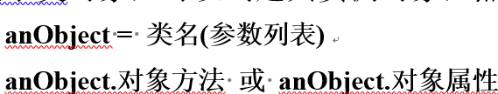

2.8 Classes and Objects
Creating Class Objects
Instance object creation and invocation
[Example 2.34] Class and Object Example (Person.py): Define the class Person, create its objects, and call the object methods
class Person: # Define the class Person
def sayHello(self): #define the function sayHello of class Person
print('Hello, how are you?')
p = Person() #create the object
p.sayHello() # call the object's method

Slide 41
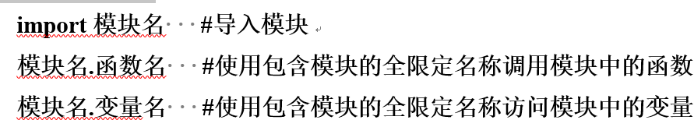
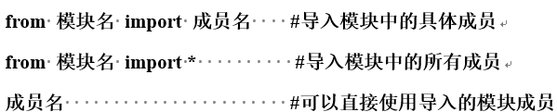
2.9 Modules and Packages
Source files that contain Python code (often with user-defined variables, functions, and classes) are called modules and have the extension .py
Modules with similar functionality can be organized into packages, which are a hierarchical organization of modules
The import statement allows you to import a module and use the functionality it defines.
You can also use the from ... import statement to import members directly into a module.

Slide 42

Examples of modules and packages
[Example 2.35] Examples of modules and packages（module1.py）：Solving quadratic equations x2+5x+6=0
import math #Import the standard module math
a = 1; b = 5; c = 6 # Variables a, b and c point to int objects 1, 5 and 6 respectively
x1 = (-b + math.sqrt(b*b - 4*a*c))/(2*a) #Use the function sqrt from the module math to solve for square roots
x2 = (-b - math.sqrt(b*b - 4*a*c))/(2*a)
print('The solution to the equation x*x + 5*x + 6 = 0 is:', x1, x2) #Output the two solutions of the quadratic equation

Slide 43
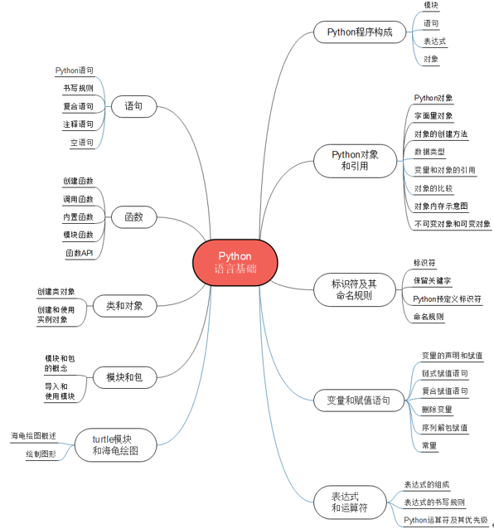
Summary of the chapter

Slide 44
2.10 Integrated applications: turtle module and turtle mapping
So-called turtle drawing assumes that a turtle (which carries a pen) moves back and forth across a screen, drawing straight lines as it moves. The turtle can move a specified distance along the line, or it can rotate at a specified angle.
By writing code, you can control the movement of turtles and plotting to create graphs

Slide 45
Overview of the turtle module
(1) Import turtle module
(2) create a turtle object (turtle module also implements the function mode, so you can also not create a turtle object, directly call the function drawing)
(3) Setting the drawing properties of the turtle (properties of the brush, color, width of the drawing line)
(4) Control and operation of sea turtle mapping
pendown()/pd()/down() #plot the graph when moving, default is draw
penup()/pu()/up() #Does not draw graphics when moving
forward(distance)/fd(distance) # move forward the distance specified by distance
backward(distance)/bk(distance)/back(distance) #move backward the distance specified by distance

Slide 46
Control and manipulation of turtle drawings
right(angle)/rt(angle) #rotate the angle specified by angle to the right
left(angle)/lt(angle) #rotate angle to the left by the specified angle
goto(x,y)/setpos(x,y)/setposition(x,y) #Move the brush to the position with coordinates (x,y)
dot(size=None, *color) #draws a dot of the specified size
circle(radius, extent=None, steps=None) #Draw a circle of the specified size.
write(arg, move=False, align='left', font=('Arial', 8, 'normal')) #draw text
stamp() #copy the current graph
speed(speed) # the speed at which the brush is drawing (an integer between [0,10])
showturtle()/st() #showturtle
hideturtle()/ht() #hideturtle
clear() #clears the graph drawn by the turtle
reset() #clears the graph drawn by the turtle and resets the turtle's properties

Slide 47
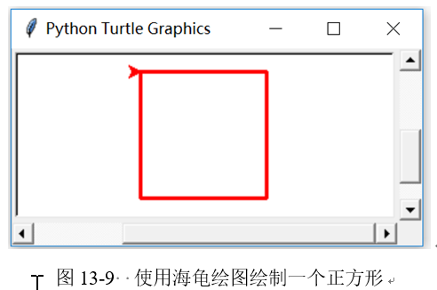
Drawing Squares
[Example 2.36] Drawing a Square Using Turtle Drawing (square.py)
import turtle #Import the turtle module
p = turtle.Turtle() #create turtle object
p.color("red") #Set the color of the brush when drawing
p.pensize(3) #define the line width of the brush when drawing
turtle.speed(1) #define the speed of the drawing ("slowest" or 1)
p.goto(0,0) #move the turtle to the coordinate origin (0,0)
p.forward(100) # move forward 100
p.right(90) # rotate 90 degrees to the right
p.forward(100) # move forward 100
p.right(90) # rotate 90 degrees to the right
p.forward(100) # move forward 100
p.right(90) # rotate 90 degrees to the right
p.forward(100) # move forward 100
p.right(90) # rotate 90 degrees to the right
(1) The turtle is drawn with its origin (0,0) in the center of the canvas area.
(2) The 8 lines of code for drawing the four sides of the square are repeated 4 times.
We will optimize the program in Chapter 3 by using the function of the loop structure to repeat
the code execution

Slide 48
Case Study: Processing Image Files with the Pillow Library
This chapter's case study uses modules and objects from the Python image processing library Pillow to process images, implementing basic image processing tasks such as reading images, obtaining image information, resizing images, rotating images, smoothing images, and cropping images.
The main purpose of the case studies in this chapter is to help students understand the basic ideas and approaches when using open-source Python software libraries developed by third parties to solve real-world problems, before launching into the details of the Python language.
The solution and source code etc. of the case studies are provided in electronic format, please scan the QR code in the tutorial for details

Slide 49
Case Study: Processing Image Files with the Pillow Library
[Example CS2.1] Install the Pillow library using pip.
Run a command line prompt as administrator and enter the command: pip3 install Pillow to install the Pillow library
[Example CS2.2] Open and display images.
>>> import PIL; from PIL import Image
>>> im = PIL.Image.open("c:/pythonpa/cs/img/mandrill.jpg")
>>> im.show()
>>> print(im.format, im.size, im.mode) #Display the format, size and mode information of the image
[Example CS2.3] Example of basic image manipulation (image_test.py)
Arrange the 4 copies of an image into a 2×2 grid and display it: the copy in the upper left is the original image, while the upper right, lower left, and lower right of the screen are filtered using the built-in filters CONTOUR, EMBOSS, and FIND_EDGES, respectively, as defined in the module PIL.ImageFilter.

Slide 50
Case Study: Processing Image Files with the Pillow Library
[Example CS2.4] Batch image format conversion (image_convert.py)
Convert all jpg files to png files
[Example CS2.5] Batch creation of thumbnails (image_thumbnail.py)
All *.jpg files converted to *_s.jpg thumbnails
[Example CS2.6] Batch image plus text watermark (image_watermark1.py)
Watermark all *.jpg files with "Python" and save as *_w.jpg.
[Example CS2.7] Batch image plus image watermark (image_watermark2.py)
Watermark all *.jpg files python-logo.png and save as *_w.jpg
[Example CS2.8] Batch Resize Images (image_resize.py)
Resize all *.jpg files to 640*480 and save as *_640.jpg

Slide 51
Thank!

